Slide 1
TITLE
Logo here
Subtitle
FAITH FOR TURBULENT TIMES
1 Sep 2018
Cecil Ang
Date

Slide 2
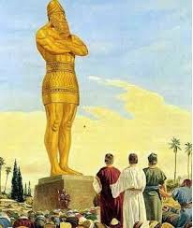
Daniel 3:1-30 GNT
King Nebuchadnezzar had a gold statue made, ninety feet high and nine feet wide, and he had it set up in the plain of Dura in the province of Babylon. ² Then the king gave orders for all his officials to come together—the princes, governors, lieutenant governors, commissioners, treasurers, judges, magistrates, and all the other officials of the provinces. They were to attend the dedication of the statue which King Nebuchadnezzar had set up. ³ When all these officials gathered for the dedication and stood in front of the statue, ⁴ a herald announced in a loud voice, “People of all nations, races, and languages! ⁵ You will hear the sound of the trumpets, followed by the playing of oboes, lyres, zithers, and harps; and then all the other instruments will join in. As soon as the music starts, you are to bow down and worship the gold statue that King Nebuchadnezzar has set up. ⁶ Anyone who does not bow down and worship will immediately be thrown into a blazing furnace.”

Slide 3
Daniel 3:1-30 GNT
⁷ And so, as soon as they heard the sound of the instruments, the people of all the nations, races, and languages bowed down and worshiped the gold statue which King Nebuchadnezzar had set up. ⁸ It was then that some Babylonians took the opportunity to denounce the Jews. ⁹ They said to King Nebuchadnezzar, “May Your Majesty live forever! ¹⁰ Your Majesty has issued an order that as soon as the music starts, everyone is to bow down and worship the gold statue, ¹¹ and that anyone who does not bow down and worship it is to be thrown into a blazing furnace. ¹² There are some Jews whom you put in charge of the province of Babylon—Shadrach, Meshach, and Abednego—who are disobeying Your Majesty's orders. They do not worship your god or bow down to the statue you set up.” ¹³ At that, the king flew into a rage and ordered the three men to be brought before him. ¹⁴ He said to them, “Shadrach, Meshach, and Abednego, is it true that you refuse to worship my god and to bow down to the gold statue I have set up?

Slide 4
Daniel 3:1-30 GNT
¹⁵ Now then, as soon as you hear the sound of the trumpets, oboes, lyres, zithers, harps, and all the other instruments, bow down and worship the statue. If you do not, you will immediately be thrown into a blazing furnace. Do you think there is any god who can save you?” ¹⁶ Shadrach, Meshach, and Abednego answered, “Your Majesty, we will not try to defend ourselves. ¹⁷ If the God whom we serve is able to save us from the blazing furnace and from your power, then he will. ¹⁸ But even if he doesn't, Your Majesty may be sure that we will not worship your god, and we will not bow down to the gold statue that you have set up.” ¹⁹ Then Nebuchadnezzar lost his temper, and his face turned red with anger at Shadrach, Meshach, and Abednego. So he ordered the furnace to be heated seven times hotter than usual. ²⁰ And he commanded the strongest men in his army to tie the three men up and throw them into the blazing furnace. ²¹ So they tied them up, fully dressed—shirts, robes, caps, and all—and threw them into the blazing furnace.

Slide 5
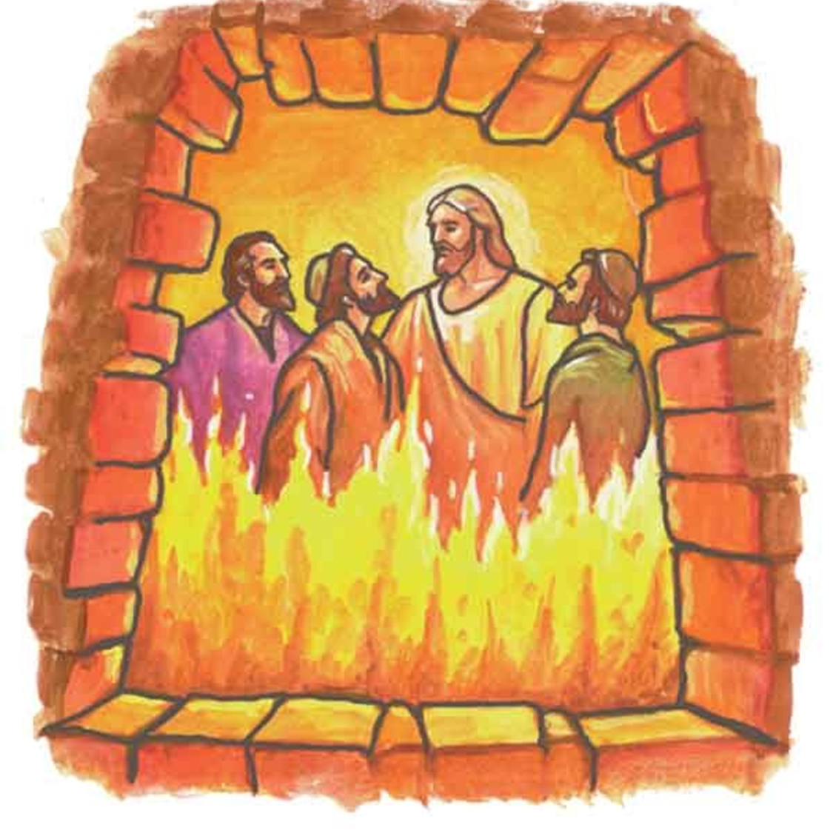
Daniel 3:1-30 GNT
²² Now because the king had given strict orders for the furnace to be made extremely hot, the flames burned up the guards who took the men to the furnace. ²³ Then Shadrach, Meshach, and Abednego, still tied up, fell into the heart of the blazing fire. ²⁴ Suddenly Nebuchadnezzar leaped to his feet in amazement. He asked his officials, “Didn't we tie up three men and throw them into the blazing furnace?” They answered, “Yes, we did, Your Majesty.” ²⁵ “Then why do I see four men walking around in the fire?” he asked. “They are not tied up, and they show no sign of being hurt—and the fourth one looks like an angel.” ²⁶ So Nebuchadnezzar went up to the door of the blazing furnace and called out, “Shadrach! Meshach! Abednego! Servants of the Supreme God! Come out!” And they came out at once. ²⁷ All the princes, governors, lieutenant governors, and other officials of the king gathered to look at the three men, who had not been harmed by the fire. Their hair was not singed, their clothes were not burned, and there was no smell of smoke on them.

Slide 6
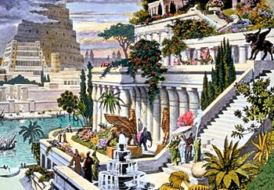
Daniel 3:1-30 GNT
²⁸ The king said, “Praise the God of Shadrach, Meshach, and Abednego! He sent his angel and rescued these men who serve and trust him. They disobeyed my orders and risked their lives rather than bow down and worship any god except their own. ²⁹ “And now I command that if anyone of any nation, race, or language speaks disrespectfully of the God of Shadrach, Meshach, and Abednego, he is to be torn limb from limb, and his house is to be made a pile of ruins. There is no other god who can rescue like this.” ³⁰ And the king promoted Shadrach, Meshach, and Abednego to higher positions in the province of Babylon.

Slide 7
Satan Craves Worship
We know that we are from God, and the whole world lies in the power of the evil one. 1 Jn 5:19 ESV
⁸ Again, the devil took him to a very high mountain and showed him all the kingdoms of the world and their glory. ⁹ And he said to him, “All these I will give you, if you will fall down and worship me.” ¹⁰ Then Jesus said to him, “Be gone, Satan! For it is written, “‘You shall worship the Lord your God and him only shall you serve.’” Mt 4:8-10 ESV

Slide 8
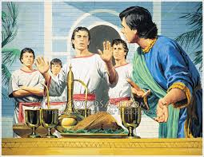
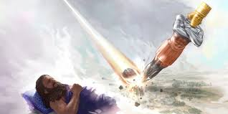
Nebuchadnezzar’s journey of faith
The king answered and said to Daniel, “Truly, your God is God of gods and Lord of kings, and a revealer of mysteries, for you have been able to reveal this mystery.” Dan 2:47 ESV
The king … found them ten times better than all the magicians and enchanters that were in all his kingdom.
Dan 1:20 ESV

Slide 9
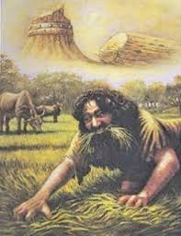
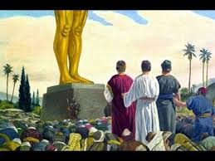
Nebuchadnezzar’s journey of faith
Nebuchadnezzar answered and said, “Blessed be the God of Shadrach, Meshach, and Abednego, who has sent his angel and delivered his servants, who trusted in him, and set aside the king's command, and yielded up their bodies rather than serve and worship any god except their own God. Dan 3:28 ESV
Now I, Nebuchadnezzar, praise and extol and honor the King of heaven, for all his works are right and his ways are just; and those who walk in pride he is able to humble. Dan 4:37 ESV

Slide 10
Nebuchadnezzar, God’s servant
⁸ “Therefore thus says the Lord of hosts: Because you have not obeyed my words, ⁹ behold, I will send for all the tribes of the north, declares the Lord, and for Nebuchadnezzar the king of Babylon, my servant, and I will bring them against this land and its inhabitants, and against all these surrounding nations. I will devote them to destruction, and make them a horror, a hissing, and an everlasting desolation. Jer 25:8-9 ESV

Slide 11
Message Outline
Object of Faith: God
Heroes of Faith: Shadrach, Meshach and Abednego
Rewards of Faith: Promotion

Slide 12
1. Object of Faith: God
Golden image erected probably in honor of Nebo, Nebuchadnezzar’s patron god; consolidation of power and enforcing loyalty
Test of faith for Daniel’s 3 friends:
Brought up with the belief that you cannot bow down to any graven image (Ex 20:4-5)
Witnessed how God honoured their vegetarian diet and gave them wisdom beyond their years
Witnessed how God answered their prayers in revealing Nebuchadnezzar’s dream and its interpretation to Daniel

Slide 13
2. Heroes of Faith: Shadrach, Meshach & Abednego
Expressed confidence in God to deliver them and at the same time submitted themselves to His will
“If the God whom we serve is able to save us from the blazing furnace and from your power, then he will. But even if he doesn't, Your Majesty may be sure that we will not worship your god, and we will not bow down to the gold statue that you have set up.” Dan 3:17-18 GNT
It takes as much faith, if not more, to trust God under threat of death to die a martyr’s death than to trust God for healing or deliverance.
Stephen – first martyr (witness)
21 Egyptian Coptic Christians
Late Sis Juline Soh

Slide 14
2. Heroes of Faith: Shadrach, Meshach & Abednego
We can exercise faith on behalf of others
³ And they came, bringing to him a paralytic carried by four men. ⁴ And when they could not get near him because of the crowd, they removed the roof above him, and when they had made an opening, they let down the bed on which the paralytic lay. ⁵ And when Jesus saw their faith, he said to the paralytic, “Son, your sins are forgiven.” Mk 2:3-5 ESV

Slide 15
3. Rewards of Faith: Promotion
For Shadrach, Meshach & Abednego, they were promoted by King Nebuchadnezzar to higher positions in his province.
For others, their promotion was not to be on earth.
Some were tortured, refusing to accept release, so that they might rise again to a better life. ³⁶ Others suffered mocking and flogging, and even chains and imprisonment. ³⁷ They were stoned, they were sawn in two, they were killed with the sword. They went about in skins of sheep and goats, destitute, afflicted, mistreated—³⁸ of whom the world was not worthy—wandering about in deserts and mountains, and in dens and caves of the earth. ³⁹ And all these, though commended through their faith, did not receive what was promised, ⁴⁰ since God had provided something better for us, that apart from us they should not be made perfect. Heb 11:35-40 ESV

Slide 16
3. Rewards of Faith: Promotion
Faith’s final reward is to be with God forever.
But you have come to Mount Zion and to the city of the living God, the heavenly Jerusalem, and to innumerable angels in festal gathering, ²³ and to the assembly of the firstborn who are enrolled in heaven, and to God, the judge of all, and to the spirits of the righteous made perfect, ²⁴ and to Jesus, the mediator of a new covenant, and to the sprinkled blood that speaks a better word than the blood of Abel. Heb 12:22-24 ESV

Slide 17
Applications
How can I exercise my faith in God for the turbulent times I am currently going through?
What can I do on behalf of others who are going through turbulent times?
When the roll is called up yonder, will I be there?

